Slide 1
IOT PATIENTS VITALS MONITORING SYSTEM
BY JOSHUA LARTEY ET AL

Slide 2
INTRODUCTION
Background/ inspiration
The stress Nurses and Doctors go through while taking vitals
Vitals being taken manually and sometimes not accurate
Impact
Save time
Accurate and Efficient vitals
Remotely monitoring the vitals of a patient.

Slide 3
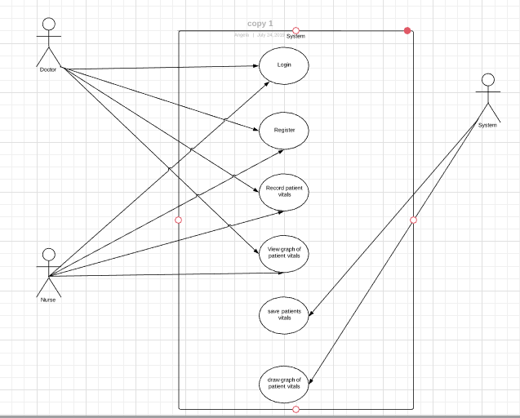
How it works - Design Use Case

Slide 4
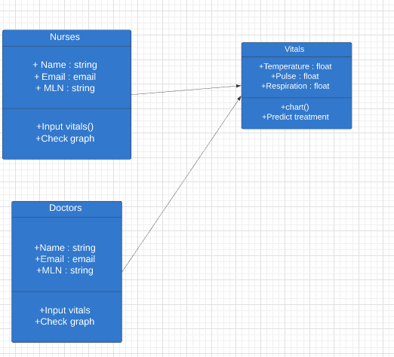
How Does It Works class diagram

Slide 5
How Does it Work – Technology Used
Python
Flask
Jinga Templates
Chart.js

Slide 6
How does it Works – How the chart.js works
from flask import Flask
from flask import Markup
from flask import Flask
from flask import render_template
app = Flask(__name__)
@app.route("/")
def chart():
labels = ["January","February","March","April","May","June","July","August"]
values = [10,9,8,7,6,4,7,8]
return render_template('chart.html', values=values, labels=labels)
if __name__ == "__main__":
app.run(host='0.0.0.0', port=5001)

Slide 7
How does it Works – How the chart.js works
<p> // get bar chart canvas<br />
var mychart = document.getElementById("chart").getContext("2d");</p>
<p> steps = 10<br />
max = 10<br />
// draw bar chart<br />
var LineChartDemo = new Chart(mychart).Line(barData, {<br />
scaleOverride: true,<br />
scaleSteps: steps,<br />
scaleStepWidth: Math.ceil(max / steps),<br />
scaleStartValue: 0,<br />
scaleShowVerticalLines: true,<br />
scaleShowGridLines : true,<br />
barShowStroke : true,<br />
scaleShowLabels: true,<br />
bezierCurve: false,</p>
<p> });</p>
<p></script>

Slide 8
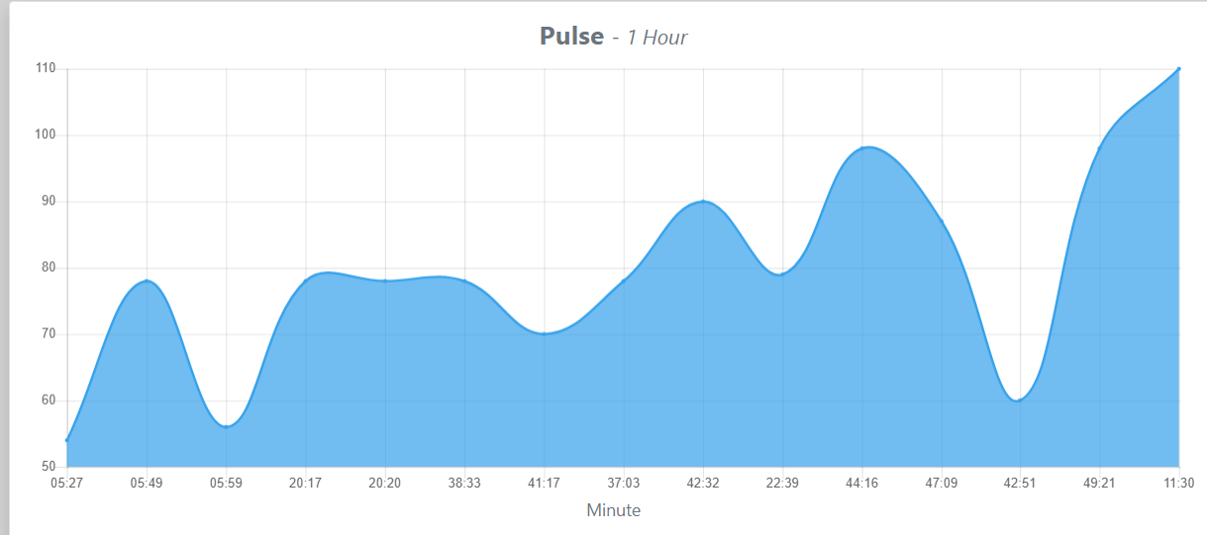
How does it Works – How the chart.js works

Slide 9
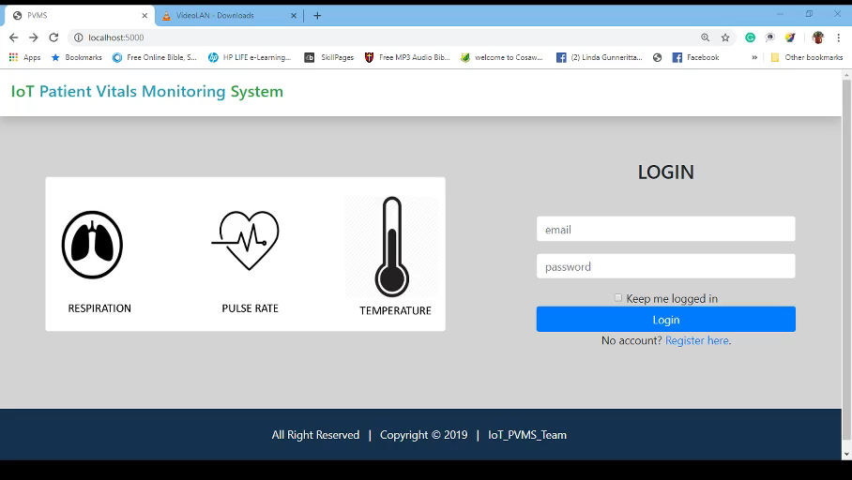
How does it Works – Live Demo

Slide 10
Where Do we Go From Here
Hosting Info
Github
Installation/ Instructions

